Slide 1
OPERATION ANALYTICS AND INVESTIGATING METRIC SPIKE
:- BY SACHIN THAKUR

Slide 2
INTRODUCTION TO PROJECT
PROJECT DESCRIPTION
APPROACH FOR PROJECT
TECHNOLOGY USED
INSIGHTS OF OPEARTION ANALYTICS
INSIGHTS OF INVESTIGATING METRIC SPIKE
OVERVIEW OF PROJECT

Slide 3
PROJECT DESCRIPTION
WE HAVE A LARGE DATASET OF JOB DATA WHICH WE USE TO ANALYSE COMPANY’S OPERATIONS.
THIS DATA HELPS TO UNDERSTAND AND EXPLAIN SUDDEN CHANGES IN KEY METRICS.
WE HAVE A WEALTH OF DATA ON JOB POSTINGS AND HIRING PRACTICES.
WE ARE USING THIS DATA TO IDENTIFY AREAS WHERE COMPANY CAN IMPROVE .
WE ARE LOOKING FOR INSIGHTS THAT CAN HELP COMPANIES ATTRACT AND RETAIN TOP TALENT.
WE BELIVE THAT THIS CAN BE USED TO MAKE A POSTITVE IMPACT ON HIRING PROCESS.
WE HANDLE MISSING VALUES , REMOVE DUPLICATES AND TRANSFORM DATA INTO SUITABLE FORMAT .
WE USE VISUALISATIONS AND STATISTICAL ANALYSIS TO EXPLORE RELATIONSHIPS BETWEEN VARIABLES .

Slide 4
APPROACH FOR PROJECT
THE DATA WAS IN VARIETY OF FORMATS , SO WE NEED TO CONVERT IT TO SQL FORMAT . SO WE EXPORTED THE DATA FROM EXCEL TO SQL .
WE USED EXCEL TO CLEAN THE DATA AND PREPARE TO IMPORT INTO SQL .
WE TOOK NOTE OF THE QUESTONS THST NEEDED TO BE ANSWERED AND THEIR DESCRIPTIONS.
WE USED SQL TO ANALYSE THE DATA AND INDENTIFY TRENDS AND PATTERNS .
WE HIGHLIGHTED THE ARES WHERE IMPROVEMENTS COULD BE MADE BASED ON DATA ANALYSIS.
WE USED VISUALISATOINS TO MAKE UNDERSTAND THE RESULTS OF OUR ANALYSIS TO STAKEHOLDERS.
WE ARE CONFIDENT THAT THE INSIGHTS WE GAINED FROM THIS ANALYSIS WILL HELP THE COMPANY IMPROVE ITS OPEARTIONS ACCORDINGLY .

Slide 5
TECHNOLOGY USED
THE TECHNOLOGIES USED FOR THE PROJECT ARE :
MYSQL WORKBENCH
MICROSOFT EXCEL
POWER BI ( FOR VISULAISATIONS )
DB FIDDLE ( FOR BIG DATA HANDLING )

Slide 6
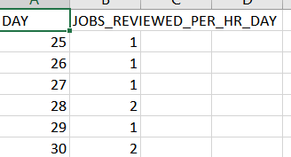
INSIGHTS OF OPEARTION ANALYTICS
CALCUALTE THE NUMBER OF JOBS REVIEWED PER HOUR PER DAY FOR NOVEMBER 2020 ?
SQL QUERY :
SELECT EXTRACT(DAY FROM DS) AS DAY , COUNT(JOB_ID/24*30))*100) AS JOBS_REVIEWD_PER_HR_DAY FROM JOB_DATA WHERE DS LIKE ‘2020-11%’ GROUP BY DAY ORDER BY DAY DESC ;

Slide 7
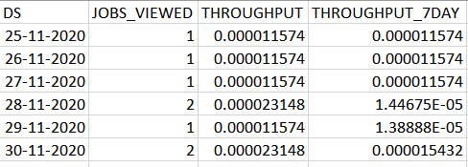
CALCULATE 7 DAY ROLLIN AVERAGE OF THROUGHPUT ?
SQL QUERY :
DROP TABLE IF EXISTS JOBS_ROLLING ;
CREATE TEMPORARY TABLE JOBS_ROLLING ( SELECT DS, COUNT(DISTINCT JOB_ID) AS JOBS_VIEWED , CAST(COUNT(DISTINCT JOB_ID)/86400 AS DECIMAL(10,10)) AS THROUGHPUT FROM JOB_DATA GROUP BY DS ORDER BY DS ) ;SELECT DS, JOBS_VIEWED , THROUGHPUT , AVG(THROUGHPUT)OVER( ORDER BY DS ROWS BETWEEN 6 PRECEDING AND CURRENT ROW ) AS THROUGHPUT_7DAY FROM JOBS_ROLLING ;

Slide 8
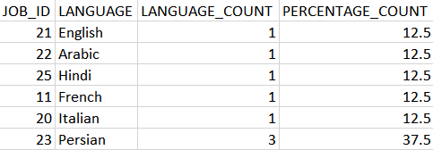
CALCUALTE THE PERCENTAGE SHARE OF EACH LANGUAGE IN LAST 30 DAYS ?
SQL QUERY :
SELECT JOB_ID ,LANGUAGE , COUNT(LANGUAGE) AS LANGUAGE_COUNT , (COUNT(LANGUAGE) / (SELECT COUNT(*) FROM JOB_DATA )) * 100 AS PERCENTAGE_COUNT FROM JOB_DATA GROUP BY JOB_ID , LANGUAGE ORDER BY PERCENTAGE_COUNT ASC;

Slide 9
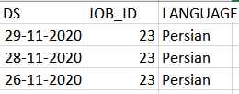
HOW WILL YOU DISPLAY DUPLICATES FROM THE TABLE ?
SQL SYNTAX :
SELECT DS , A.JOB_ID , LANGUAGE FROM JOB_DATA INNER JOIN(SELECT JOB_ID , COUNT(JOB_ID) AS DUPLICATES FROM JOB_DATA GROUP BY JOB_ID HAVING DUPLICATES > 1 ) A ON A.JOB_ID = JOB_DATA.JOB_ID ;

Slide 10
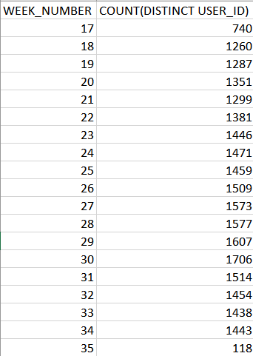
INSIGHTS INVESTIGATING METRIC SPIKE
CALCULATE THE WEEKLY USER ENGAGEMENT ?
SQL QUERY :
SELECT WEEK(OCCURED_AT) AS USER_ENGAGEMENT ,
COUNT(DISTINCT USER_ID)
AS WEEK_NUMBER FROM EVENTS GROUP BY USER_ENGAGEMENT
ORDER BY USER_ENGAGEMENT ;
SELECT EXTRACT(WEEK FROM OCCURED_AT)
AS WEEK_NUMBER, COUNT(DISTINCT USER_ID) FROM EVENTS
GROUP BY WEEK_NUMBER ORDER BY WEEK_NUMBER ;

Slide 11
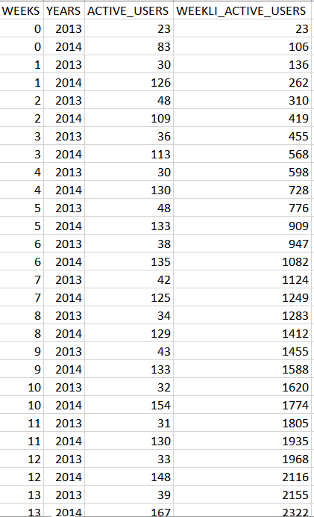
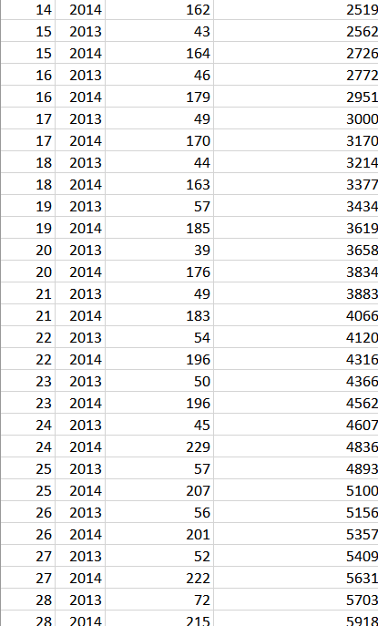
WRITE AN SQL QUERY TO CALCUALTE THE USER GROWTH OF PRODUCT ?
SQL QUERY :
SELECT WEEKS , YEARS ,ACTIVE_USERS ,
SUM(ACTIVE_USERS) OVER ( ORDER BY WEEKS ,
YEARS ROWS BETWEEN UNBOUNDED PRECEDING
AND CURRENT ROW ) AS WEEKLI_ACTIVE_USERS
FROM (SELECT EXTRACT(WEEK FROM CREATED_AT)
AS WEEKS , EXTRACT(YEAR FROM CREATED_AT)
AS YEARS,COUNT(USER_ID) AS ACTIVE_USERS FROM
USERS WHERE STATE LIKE 'ACTIVE’
GROUP BY WEEKS,YEARS ORDER BY YEARS)AS ACTIVES;
OUTPUT : THE QUERY HAS 89 ROWS RETURNED

Slide 12
CALCULATE THE WEEKLY RETENTION OF USERS BASED ON THEIR SIGN-UP COHORT ?
SQL QUERY :
WITH table1 AS ( SELECT user_id, MIN(`occured_at`) AS first_sign_up FROM EVENTS WHERE event_name = 'create_user' GROUP BY user_id),table2 AS ( SELECT table1.user_id, first_sign_up, WEEK(`occured_at`) AS retention_week FROM table1 LEFT JOIN EVENTS ON table1.user_id = eventS.user_id WHERE `occured_at` > first_sign_up )SELECT first_sign_up, retention_week, COUNT(DISTINCT user_id) AS weekly_growthFROM table2GROUP BY first_sign_up, retention_week;
OUTPUT : THE QUERY HAS 1099 ROWS RETURNED .IN NEXT OUTPUT OF FIRST AND LAST ROWS IMAGES .

Slide 13
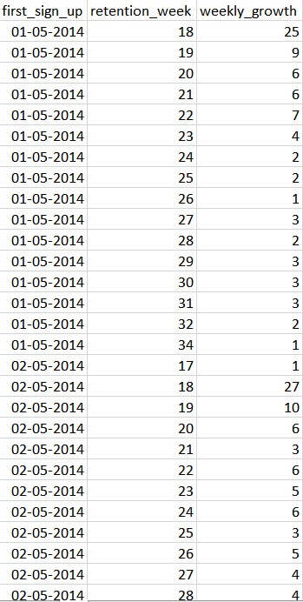
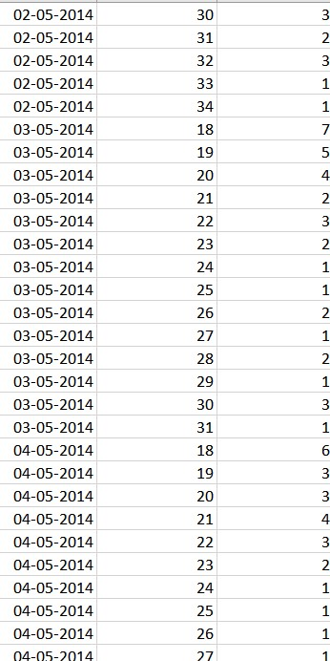
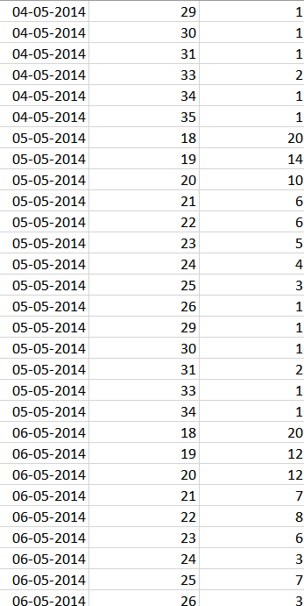

Slide 14
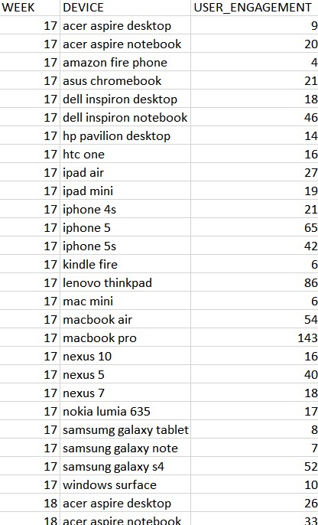
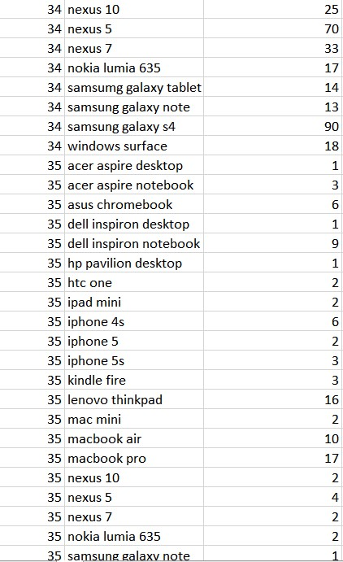
CALCUALTE THE WEEKLY ENGAGEMENT PER DEVICE ?
SQL QUERY :
SELECT EXTRACT(WEEK FROM OCCURED_AT) AS WEEK ,DEVICE, COUNT(DISTINCT USER_ID) AS USER_ENGAGEMENT FROM EVENTS WHERE EVENT_TYPE LIKE 'ENGAGEMENT' GROUP BY DEVICE, WEEK ORDER BY WEEK;
O/P : THE RESULT HAS
491 ROWS RETURNED
-> OUTPUT OF FIRST AND
LAST VALUES OF THE
QUERY.

Slide 15

calculate the email engagement metrics.
SQL QUERY :
SELECT SUM(CASE WHEN ACTION = 'EMAIL_OPEN' THEN 1 ELSE NULL END)/COUNT(DISTINCT USER_ID) AS OPENING_RATE ,SUM(CASE WHEN ACTION = 'EMAIL_CLICKTHROUGH' THEN 1 ELSE NULL END)/COUNT(DISTINCT USER_ID)AS CLICK_THROUGHRATE FROM EMAIL_EVENTS ;

Slide 16
OVERVIEW ANALYSIS OF PROJECT
The data was not as comprehensive as we would have liked, but it was still sufficient to gain some insights.
The daily number of reviews was relatively low, but it was consistent over time.
The Persian language was the clear favorite among users, with a significant majority of reviews being written in that language.
The duplicate entries identified in the dataset may be due to a technical error or human error.
Further investigation is needed to determine the cause of the duplicate entries and to ensure the accuracy of the data.
-> THANK YOU <-
SACHIN THAKUR

